Slide 1
Making Causal Claims as a Data Scientist: Tips and Tricks Using R
Lucy D’Agostino McGowan

Slide 2
http://bit.ly/LucyStatsDDT2018

Slide 3
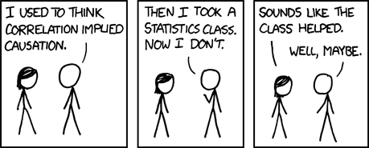
https://xkcd.com/552/

Slide 4
https://xkcd.com/552/

Slide 5
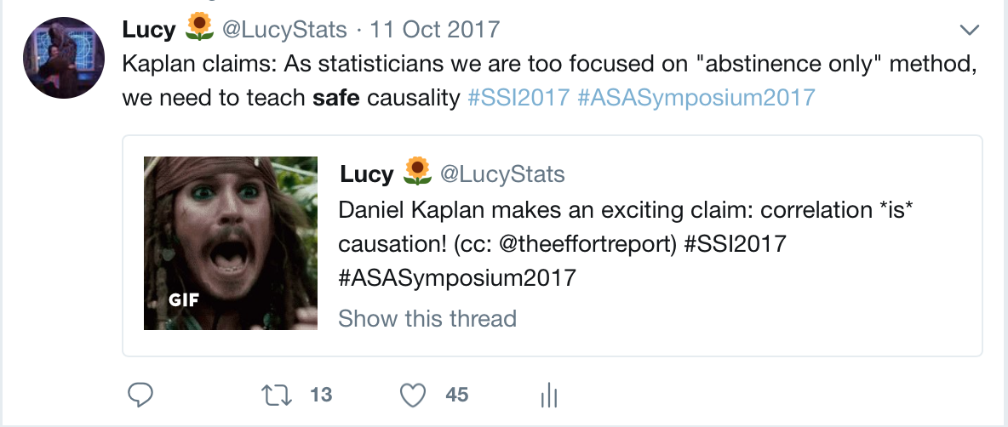
Notes:
Daniel Kaplan, a professor in Mathematics & Computer Science, Macalester College

Slide 6
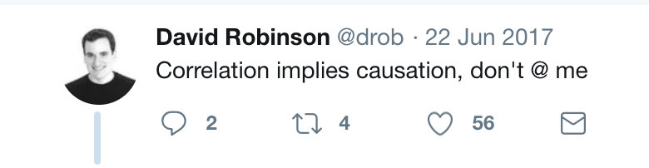

Slide 7
✌️ parts
Discuss some ways to strengthen a causal argument: Hill’s criteria
Discuss a specific causal inference method: propensity scores + sensitivity analyses

Slide 8
Hill’s Criteria
https://commons.wikimedia.org/wiki/File:Austin_Bradford_Hill.jpg
Notes:
Sir Austin Bradford Hill, a statistician and epidemiologist, created a list of guidelines for evaluating whether there is evidence of a causal relationship.[1] He determined the following aspects of associations ought to be considered when assessing causality.

Slide 9
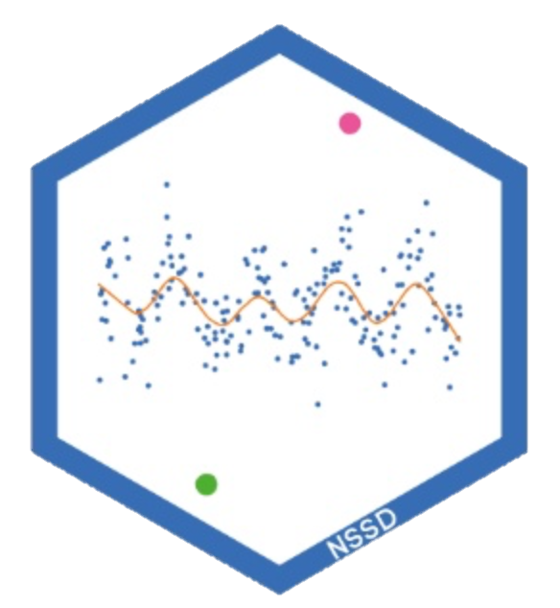
http://nssdeviations.com
http://livefreeordichotomize.com/2016/12/15/hill-for-the-data-scientist-an-xkcd-story/
Notes:
Hilary Parker&Roger Peng’s Not So Standard Deviations Episode 28

Slide 10
https://xkcd.com/539/
Strength
Notes:
How big is the effect you are seeing?
Note: Hill suggests that huge effects can suggest causality, however this does not mean small effects cannot

Slide 11
Consistency
https://xkcd.com/242/
Notes:
This is essentially reproducibility &replicability
Can your analysis be reproduced?
Has anyone been able to replicate your findings?

Slide 12
Specificity
https://xkcd.com/1217/
Notes:
Can the association be pinpointed to a specific cause with no other plausible explanation?
I appreciate Hill’s caveat here, “if specificity exists we may be able to draw conclusions without hesitation; if it is not apparent, we are not thereby necessarily left sitting irresolutely on the fence.”

Slide 13
Temporality
https://xkcd.com/925/
Notes:
Does the timeline make sense?
In general, the exposure ought to come before the outcome it is said to cause.

Slide 14
Biological
gradient
https://xkcd.com/323/
Notes:
The wording of this point makes it a bit difficult to untangle from the medical application, but generally this refers to a dose effect
Does increasing an exposure yield a change in the outcome.

Slide 15
Plausibility
https://xkcd.com/605/

Slide 16
https://xkcd.com/1170/
Coherence
Notes:
Similar to plausibility, is there a logical argument that can be made by/to experts in the field regarding causality.
Does it fit into the understanding of the field (authors note: this should have caveats too…the field could be wrong).

Slide 17
Analogy
https://xkcd.com/882/
Notes:
Have we seen a similar effect from a similar exposure?

Slide 18
Experiment
https://xkcd.com/1462/

Slide 19
What if you can’t do a controlled experiment?

Slide 20

Observational Studies
Goal: Answer a research question
exposure
outcome

Slide 21
Observational Studies
“Gold Standard” – Randomized Controlled Trials
Treatment
P=0.5
Control
P=0.5

Slide 22
Observational Studies
“Gold Standard” – Randomized Controlled Trials
A
P=0.5
B
P=0.5

Slide 23
Observational Studies
Treatment
P=0.9
Control
P=0.1

Slide 24
Observational Studies
Exposed
P=0.8
Unexposed
P=0.2

Slide 25
Observational Studies
Exposed
P=0.8
Unexposed
P=0.2

Slide 26
Observational Studies
Exposed
P=0.9
Unexposed
P=0.1

Slide 27


Slide 29
Confounding
Confounder
Exposure
Outcome

Slide 30
Confounding
Confounder
Exposure
Outcome

Slide 31
Meaningful confounders
1. How imbalanced is the confounder between the exposure groups?
2. How predictive is the confounder of the outcome?

Slide 32
Confounding
Confounder
Exposure
Outcome

Slide 33
Meaningful confounders
1. How imbalanced is the confounder between the exposure groups?
2. How predictive is the confounder of the outcome?

Slide 34
Confounding
Confounder
Exposure
Outcome

Slide 36
Propensity scores
Rosenbaum and Rubin showed in observational studies, conditioning on propensity scores can lead to unbiased estimates of the exposure effect
There are no unmeasured confounders
Every subject has a nonzero probability of receiving either exposure

Slide 37
Propensity scores
Rosenbaum and Rubin showed in observational studies, conditioning on propensity scores can lead to unbiased estimates of the treatment effect
There are no unmeasured confounders
Every subject has a nonzero probability of receiving either treatment

Slide 38

Propensity scores
Fit a logistic regression predicting exposure using known covariates
$$Pr\left(exposure=1\right)=\frac{1}{1+exp\left(−Xβ\right)}$$
Each individuals' predicted values are the propensity scores

Slide 39
Propensity scores
glm(exposure ~ smoker + cowboy_hat + sick . . .,
data = df,
family = binomial)

Slide 40
Propensity scores
glm(exposure ~ smoker + cowboy_hat + sick . . .,
data = df,
family = binomial) %>%
predict()

Slide 41
Propensity scores
glm(exposure ~ smoker + cowboy_hat + sick . . .,
data = df,
family = binomial) %>%
predict()
#> 1 2 3 4 5 #> 0.831823 0.562374 0.942197 2.288641 0.366256

Slide 42
Propensity scores
glm(exposure ~ smoker + cowboy_hat + sick . . .,
data = df,
family = binomial) %>%
predict(type = “response”)

Slide 43
Propensity scores
glm(exposure ~ smoker + cowboy_hat + sick . . .,
data = df,
family = binomial) %>%
predict(type = “response”)
#> 1 2 3 4 5 #> 0.6967404 0.6370019 0.7195434 0.9079320 0.5905542

Slide 44
Propensity scores
p <- glm(exposure ~ smoker + cowboy_hat + sick . . .,
data = df,
family = binomial) %>%
predict(type = “response”)

Slide 45
Propensity scores
0.9
0.2
0.1
0.3
0.7
0.3
0.1
0.6
0.6
0.9
0.2
0.2
0.3
0.1
0.1
0.8
0.7
0.7
0.8
0.2
0.2

Slide 46
Propensity scores
0.9
0.2
0.1
0.3
0.6
0.6
0.9
0.2
0.3
0.1
0.8
0.7
0.7
0.8
0.2
0.2

Slide 47
Propensity scores
0.2
0.2
0.3
0.6
0.7
0.8
0.9
0.1
0.1
0.2
0.2
0.3
0.6
0.7
0.8
0.9

Slide 48
Propensity Scores
Weighting
Matching
Stratification
Direct Adjustment
…

Slide 49
Propensity Scores
Weighting
Matching
Stratification
Direct Adjustment
…

Slide 50

Weighting
$$w_{ATM}=\frac{\min{\{p_{i}, 1−p_{i}\}}}{Z_{i}p_{i}+(1−Z_{i})(1−p_{i})}$$

Slide 51
Weighting
p_0 <- 1 - p
df$weight <- pmin(p, p_0) /
ifelse(exposure == 1, p, p_0)

Slide 52
Imbalance between exposures
0.2
0.2
0.3
0.6
0.7
0.8
0.9
0.1
0.1
0.2
0.2
0.3
0.6
0.7
0.8
0.9

Slide 53
Propensity Scores
Imbalance between exposures
0.2
0.2
0.3
0.6
0.7
0.8
0.9
0.1
0.1
0.2
0.2
0.3
0.6
0.7
0.8
0.9

Slide 54
Propensity scores
0.1
0.2
0.2
0.3
0.6
0.7
0.8
0.9
0.1
0.2
0.2
0.3
0.6
0.7
0.8
0.9
0.1
0.2
0.2
0.3
0.6
0.7
0.8
0.9
0.1
0.2
0.2
0.3
0.6
0.7
0.8
0.9
0.1
0.2
0.2
0.3
0.6
0.7
0.8
0.9
0.1
0.2
0.2
0.3
0.6
0.7
0.8
0.9
0.1
0.2
0.2
0.3
0.6
0.7
0.8
0.9
0.1
0.2
0.2
0.3
0.6
0.7
0.8
0.9

Slide 55
0.1
0.2
0.2
0.3
0.6
0.7
0.8
0.9
0.1
0.2
0.2
0.3
0.6
0.7
0.8
0.9
0.1
0.2
0.2
0.3
0.6
0.7
0.8
0.9
0.1
0.2
0.2
0.3
0.6
0.7
0.8
0.9
0.1
0.2
0.2
0.3
0.6
0.7
0.8
0.9
0.1
0.2
0.2
0.3
0.6
0.7
0.8
0.9
0.1
0.2
0.2
0.3
0.6
0.7
0.8
0.9
0.1
0.2
0.2
0.3
0.6
0.7
0.8
0.9
0.1
0.2
0.2
0.3
0.6
0.7
0.8
0.9
0.1
0.2
0.2
0.3
0.6
0.7
0.8
0.9
0.1
0.2
0.2
0.3
0.6
0.7
0.8
0.9
0.1
0.2
0.2
0.3
0.6
0.7
0.8
0.9
0.1
0.2
0.2
0.3
0.6
0.7
0.8
0.9
0.1
0.2
0.2
0.3
0.6
0.7
0.8
0.9
0.1
0.2
0.2
0.3
0.6
0.7
0.8
0.9
0.1
0.2
0.2
0.3
0.6
0.7
0.8
0.9
0.1
0.2
0.2
0.3
0.6
0.7
0.8
0.9
0.1
0.2
0.2
0.3
0.6
0.7
0.8
0.9
0.1
0.2
0.2
0.3
0.6
0.7
0.8
0.9
0.1
0.2
0.2
0.3
0.6
0.7
0.1
0.2
0.2
0.3
0.6
0.7
0.8
0.9
0.1
0.2
0.2
0.3
0.6
0.7
0.8
0.9
0.1
0.2
0.2
0.3
0.6
0.7
0.8
0.9

Slide 56
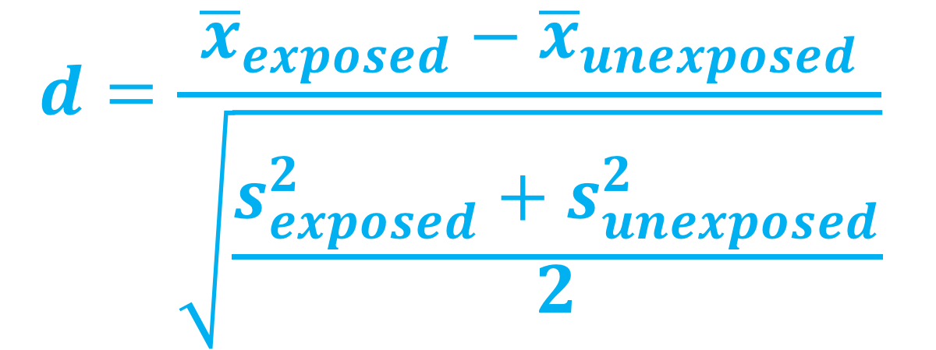
Standardized mean difference
$$d=\frac{{\overline{x}}_{exposed}−{\overline{x}}_{unexposed}}{\sqrt{\frac{s_{exposed}^{2}+s_{unexposed}^{2}}{2}}}$$

Slide 57
Standardized Mean Difference
library(survey)
svy_des <- svydesign(
ids = ~ 1,
data = df,
weights = ~ weight)

Slide 58
Standardized Mean Difference
library(tableone)
smd_table <- svyCreateTableOne(
vars = c(“smoker”, “cowboy_hat”, “sick”, . . .),
strata = “exposure”,
data = svy_des,
test = FALSE)
print(smd_table, smd = TRUE)

Slide 59
Standardized Mean Difference
 | Exposed | Unexposed | SMD
n | 1897.07 | 1900.24
mustache | 60.71 (16.95) | 60.90 (15.61) | 0.012
cowboy hat | 204.59 (101.45) | 202.90 (106.44) | 0.016
glasses | 70.77 (27.00) | 70.51 (27.50) | 0.01
smoker | 37.46 (10.93) | 37.40 (11.28) | 0.005
crazy hair | 2.27 (2.46) | 2.27 (1.82) | 0.003
smile | 2.49 (5.48) | 2.47 (4.80) | 0.003
sick | 30.92 (8.23) | 30.95 (7.54) | 0.003
harry potter | 3.04 (0.69) | 3.03 (0.93) | 0.01
healthy | 145.4 (7.7) | 152.2 (8.0) | 0.013

Slide 60
Standardized Mean Difference
library(tableone)
smd_table_unweighted <- CreateTableOne(
vars = c(“smoker”, “cowboy_hat”, “sick”, . . .),
strata = “exposure”,
data = df,
test = FALSE)
print(smd_table_unweighted, smd = TRUE)

Slide 61
Love Plots

Slide 62
Imbalance between exposures
Love Plots

Slide 63
Standardized Mean Difference
library(tidyr)
plot_df <- data.frame(
var = names(ExtractSmd(smd_table)),
Unadjusted = ExtractSmd(smd_table_unweighted ),
Weighted = ExtractSmd(smd_table)) %>%
gather("Method", "SMD", -var)

Slide 64
Standardized Mean Difference
library(ggplot2)
ggplot(
data = plot_df,
mapping = aes(x = var, y = SMD, group = Method, color = Method)
) +
geom_line() +
geom_point() +
geom_hline(yintercept = 0.1, color = "black", size = 0.1) +
coord_flip()

Slide 65
Love Plots

Slide 66
Outcome model
svyglm(
outcome ~ exposure,
data = svy_des,
family = binomial)

Slide 67
Outcome model
svyglm(
outcome ~ exposure,
data = svy_des,
family = binomial) %>%
confint(parm = “exposure”)

Slide 68
Outcome model
svyglm(
outcome ~ exposure,
data = svy_des,
family = binomial) %>%
confint(parm = “exposure”) %>%
exp()
#> 2.5% 97.5%
#> exposure 1.51 2.01

Slide 69
unmeasured confounding

Slide 70
All you need
Exposure-outcome effect
Exposure-unmeasured confounder effect
Outcome-unmeasured confounder effect

Slide 71
All you need
Exposure-outcome effect generally estimated from a model, for example an odds ratio, hazard ratio, or risk ratio
Exposure-unmeasured confounder effect
Outcome-unmeasured confounder effect
Odds Ratio Confidence Interval: (1.5, 2)

Slide 72
All you need
Exposure-outcome effect generally estimated from a model, for example an odds ratio, hazard ratio, or risk ratio
Exposure-unmeasured confounder effect
Outcome-unmeasured confounder effect

Slide 73

Tipping point analyses
what will tip our confidence bound to cross 1

Slide 74
All you need
Exposure-outcome effect generally estimated from a model, for example an odds ratio, hazard ratio, or risk ratio
Exposure-unmeasured confounder effect can use my observed variables to estimate this
Outcome-unmeasured confounder effect

Slide 75
All you need
Exposure-outcome effect generally estimated from a model, for example an odds ratio, hazard ratio, or risk ratio
Exposure-unmeasured confounder effect can use my observed variables to estimate this
Outcome-unmeasured confounder effect

Slide 76
Exposure-unmeasured confounder effect
Prevalence of the unmeasured confounder among the exposed
Prevalence of the unmeasured confounder among the unexposed

Slide 77


$p_{0}=0.1$
$$p_{1}=0.3$$
Love Plots

Slide 78
Confounding
Confounder
$p_{0}=0.1$
?
$$p_{1}=0.3$$
Exposure
Outcome
Odds Ratio Confidence Interval: (1.5, 2)

Slide 79
Standardized Mean Difference
library(tipr)
tip_with_binary(
p0 = 0.1,
p1 = 0.3,
lb = 1.5,
ub = 2)

Slide 80
Standardized Mean Difference
library(tipr)
tip_with_binary(
p0 = 0.1,
p1 = 0.3,
lb = 1.5,
ub = 2)
#> [1] 4.333333

Slide 81
“
A hypothetical unobserved binary confounder that is prevalent in 30% of the exposed population and 10% of the unexposed population would need to have an association with Y of 4.33 to tip this analysis at the 5% level, rendering it inconclusive.
”

Slide 82
✌️ parts
Discuss some ways to strengthen a causal argument: Hill’s criteria
Discuss a specific causal inference method: propensity scores + sensitivity analyses

Slide 83
https://xkcd.com/552/

Slide 84
R
survey
tableone
tidyr
ggplot2
tipr

Slide 85
References
Cornfield, J., Haenszel, W., Hammond, E. C., Lilienfeld, A. M., Shimkin, M. B., & Wynder, E. L. (2009). Smoking and lung cancer: recent evidence and a discussion of some questions. 1959. International journal of epidemiology (Vol. 38, pp. 1175–1191). Oxford University Press. http://doi.org/10.1093/ije/dyp289
Schlesselman, J. J. (1978). Assessing effects of confounding variables. American Journal of Epidemiology, 108(1), 3–8.
Rosenbaum, P. R., & Rubin, D. B. (1983). The Central Role of the Propensity Score in Observational Studies for Causal Effects. Biometrika, 70(1), 41. http://doi.org/10.2307/2335942
Lin, D. Y., Psaty, B. M., & Kronmal, R. A. (1998). Assessing the sensitivity of regression results to unmeasured confounders in observational studies. Biometrics, 54(3), 948–963.
https://cran.r-project.org/web/packages/tableone/vignettes/smd.html

Slide 86


Thank you!
@LucyStats
http://bit.ly/LucyStatsDDT2018
lucymcgowan.com

